Slide 1
An introduction to home solar power
(Or how I came to have a $10/month electricity bill)

Slide 2
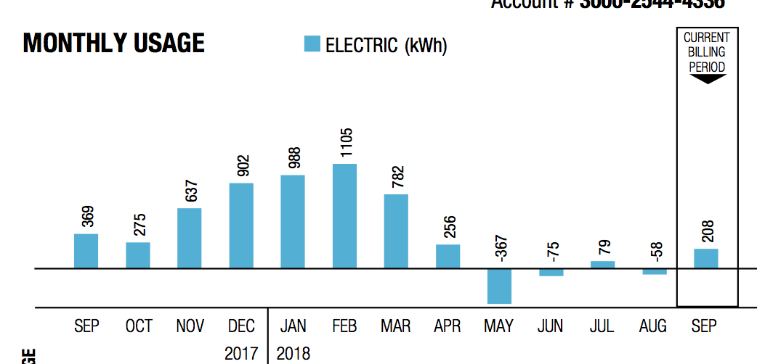
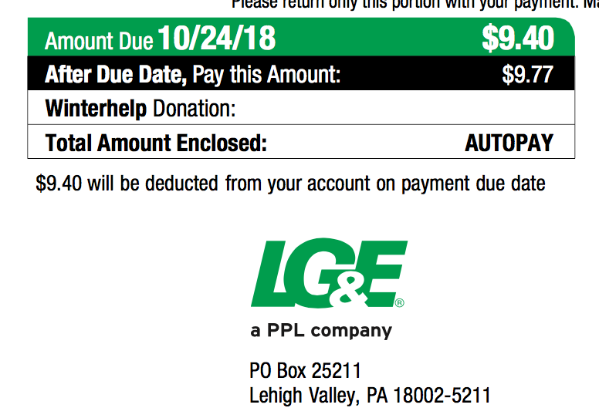

Slide 3
What’s it like to live with?
Why do it?
Before spending money on solar stuff…
Terminology
What does it cost?
Solar hot water
Off grid or grid tied
Inverter type
What would I need?
What’s involved in putting the system together?
Suppliers
Useful stuff/toys
Questions

Slide 4

What’s it like to live with?

Slide 5
No, you muppet, what’s it like to live with really?
With my system (7kw on the roof of my house, microinverters, net metering):
No maintenance (well, maybe hosing off the panels once in a while)
Electricity bill is a touch more complex to read but a LOT smaller
Er, that’s it. Plug stuff in, it works.

Slide 6
Why do it?
Low risk investment: cash saved on electricity bill is after-tax lower bills are a big resale benefit
Good for the planet (But so is roof insulation, walking places and going vegetarian)
It’s deeply cool making your own power
It is a fun DIY project
My friends and neighbors will be impressed/horrified

Slide 7
Before spending money on solar stuff…
Energy audit ($100) In my case, this led me to:
Roof insulation (12+ inches extra fiberglass insulation) ($1200)
LED lights ($200)
Seal round windows and doors ($30)
Seal the air leaks from outlet boxes (same caulk for windows)
Seal the AC ducting and insulate the duct in the roof ($100)
Hybrid water heater (GEA store has them for $500!)
Energy star roof shingles

Slide 8
Terminology
Inverter – a chunk of electronics that turns the direct current (DC) power from the panel(s) into alternating current (AC)
Kw – kilo-watt, a measure of power. A hairdryer or a drip coffee maker use about 1 kw, the dryer uses about 3 kw. A 3’x5’ solar panel makes about ¼ kw in really bright sunlight.
Kwh – kilo watt hour, or a load of 1 kw for 1 hour. When you look at the electricity bill, this is what they are counting. Before I started my house used about 40 kwh per day (2400 sq ft ranch). LG&E currently charge around $0.12/kwh.

Slide 9
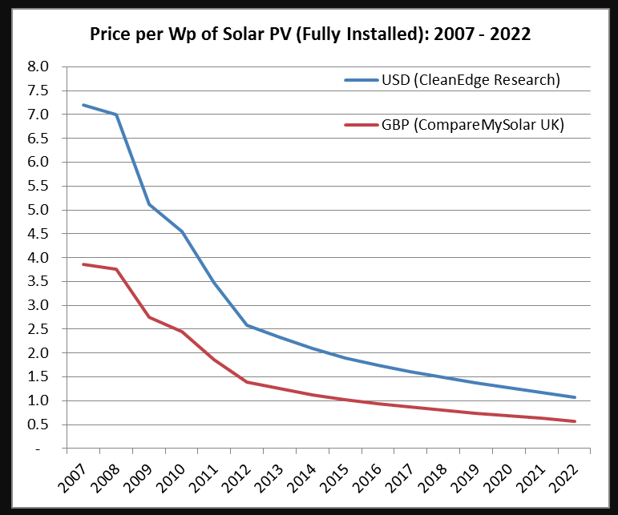
What does it cost?
Quote in 2013 for 3kw ground mount system was $18.5k.
Phase 1: 2013 DIY 5kw system (20 panels) - $11k (with $4.5k back)
Phase 2: 2016 DIY 2kw from Craigslist - $2k
Neighbor bought 3kw DIY system from Craigslist for $3.4k
You can start with a single panel system for about $300…
Until the end of 2019 you get 30% back as a tax credit ☺
Solar hot water systems can be had for about $2k
Rough guide – DIY grid-tie is $1.20/w, professional grid-tie install is $3/w to $4/w and off grid with batteries is going to be around $6/w to $7/w.

Slide 10
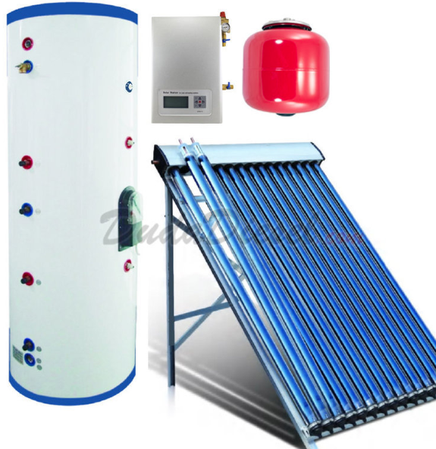
Solar hot water
Preheats water before it runs into your hot water tank
Solar collector on the roof, with a circulator pump and additional hot water tank
Water heating is 10%+ of house energy use
Best done as addition to current hot water system (preheat tank)
Some lifestyle changes …you want to run the washer, dishwasher etc. at night

Slide 11
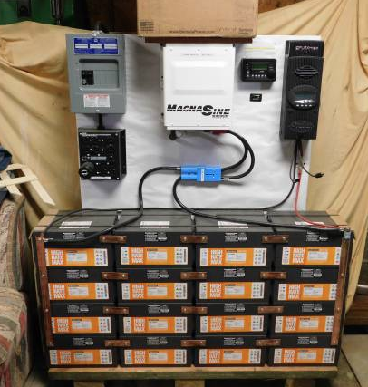
Off grid
Off grid – no electricity bill ☺
You provide all your own power – and don’t depend on the grid.
Significantly more expensive because it uses (lots of) batteries
Regular maintenance for batteries
Bad weather for prolonged periods means using backup generator
Great if the utility wants more than $20k to connect you to the grid
Almost impossible to find a professional installer that will do this for you.
*This is badly wired – don’t do this!

Slide 12
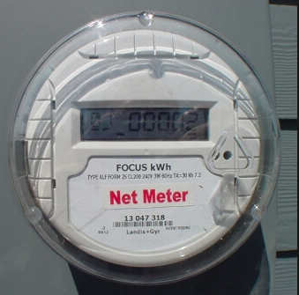
Grid tied
Grid tied – your house is still connected to the grid
You still get a bill ☹
If there’s snow on the panels for a week you still have power
You don’t have to replace all your power consumption with solar
Very low maintenance
This is what I have...

Slide 13
What would I need for grid tied PV?
You don’t need to replace all the power you use from the grid – start small!
Sun! So you need a clear view of the southern sky
Roof or space in the yard
Size of system is measured in kW – one panel is about 3’x5’ and makes about ¼ kW.
System comprises panels, inverters, wiring and a mounting system
If you needed 24kwh/day, we get about 6 hours of sunshine per day so you would need 24 / 6 or 4kw of solar panels, about 16 panels.

Slide 14
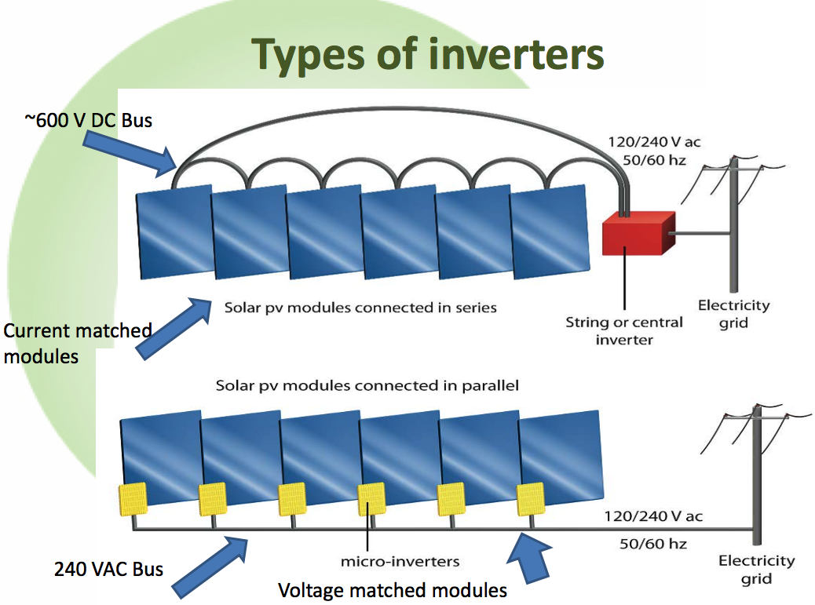

Slide 15
Inverter types
“Single string” photovoltaic solar power One or two large inverters fed by multiple panels wired together Exciting DC voltages (600v+) and issues with shading
Possibly more reliable due to inverter being inside the house and running at a lower temperature
“Micro-inverter” photovoltaic solar power One inverter every one or two panels Regular house voltages (240v AC)
More fault tolerant – one inverter failing doesn’t stop power production
“Hybrid inverter” – grid tied inverter which can also provide power if the grid goes down. There are examples that are micro inverters (IQ-8) and string inverters like Solar Edge.

Slide 16
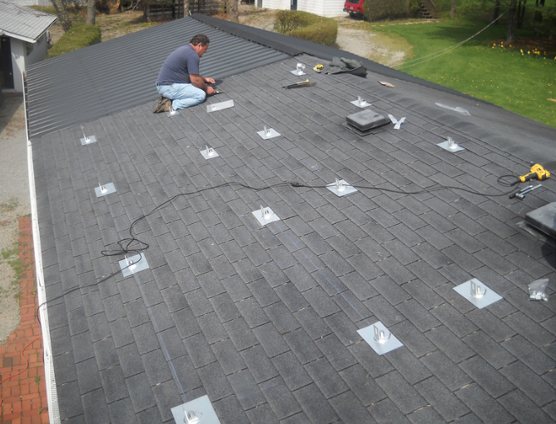
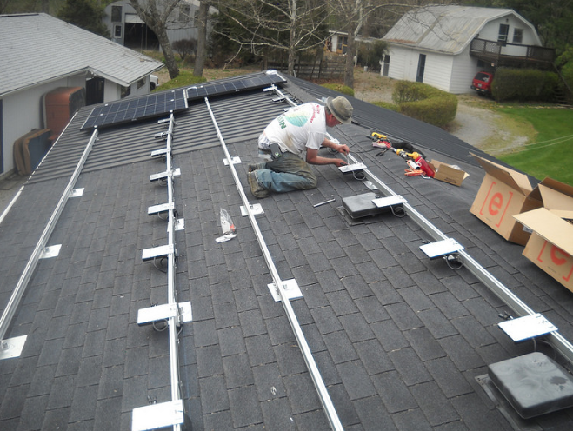
What’s involved in putting it together?

Slide 17
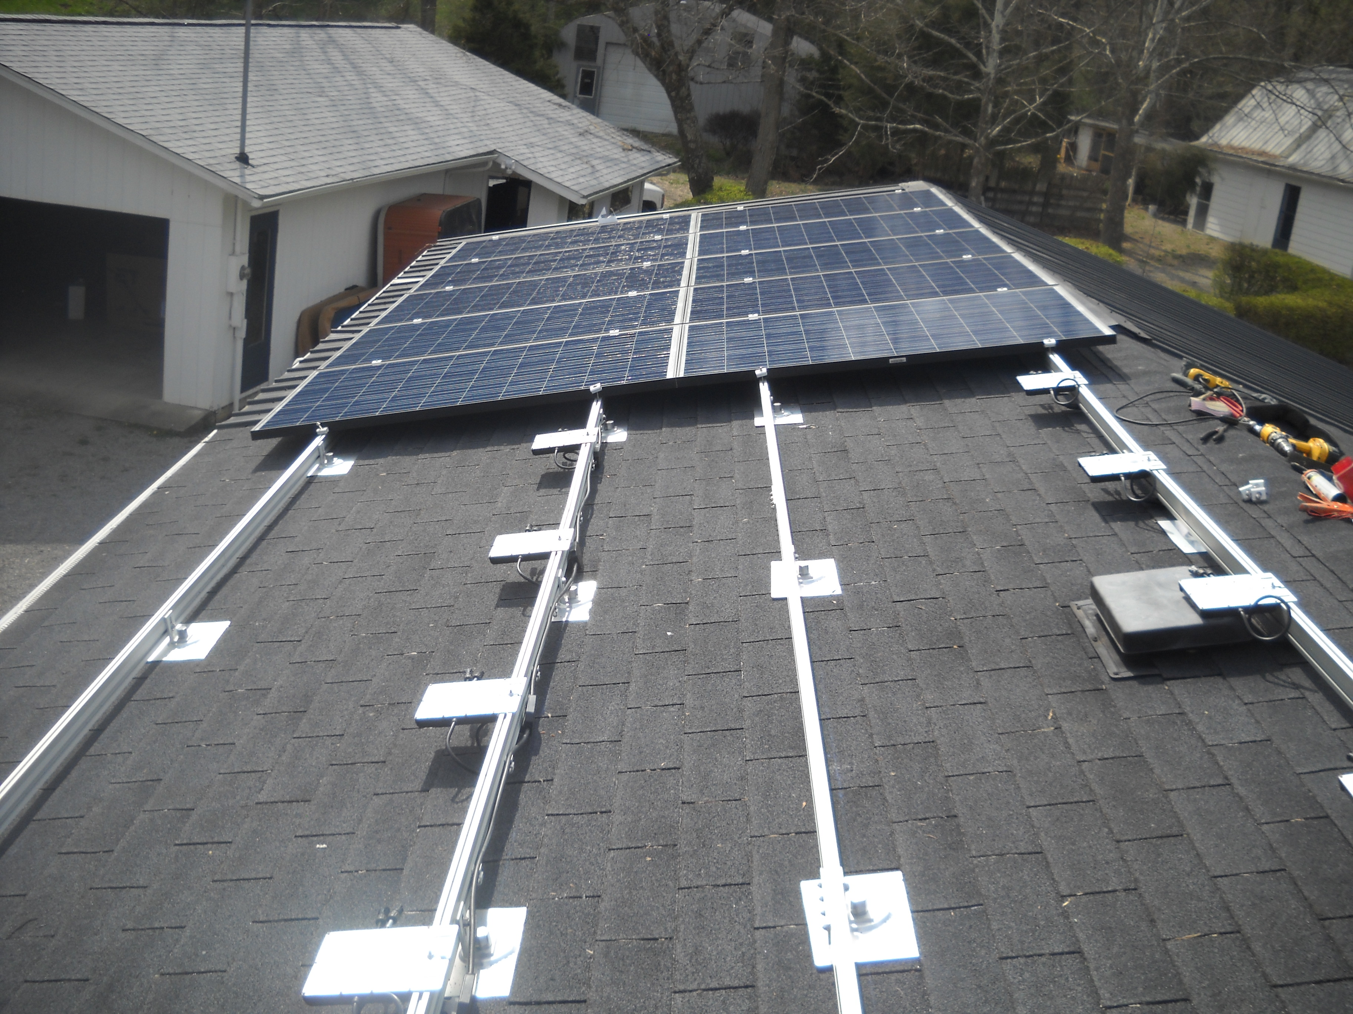
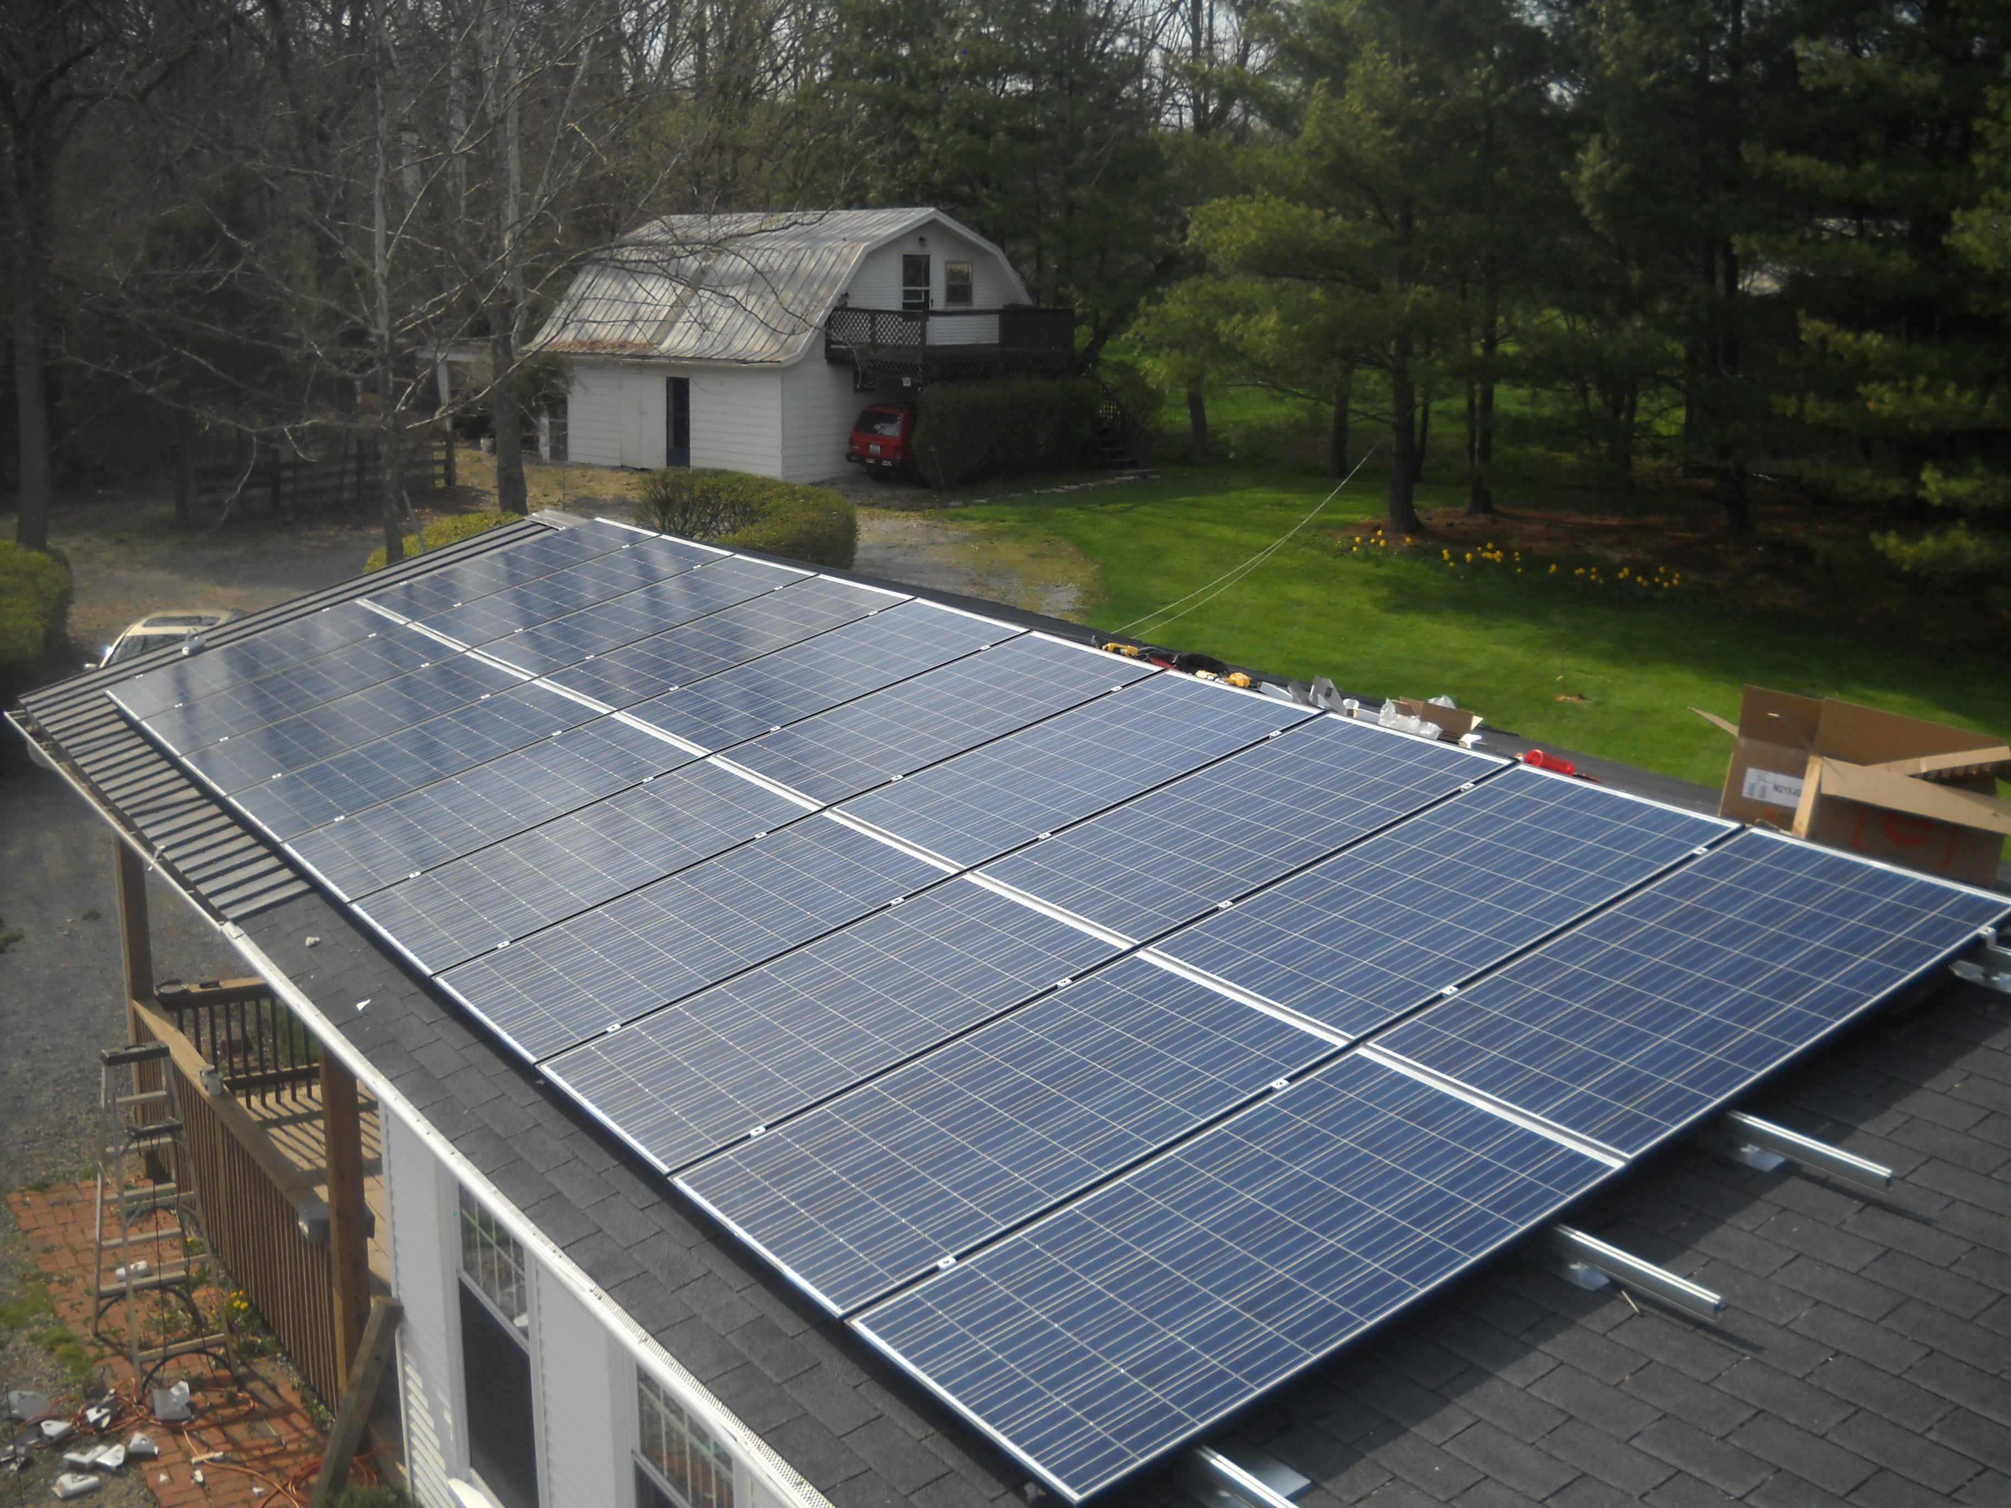

Slide 18
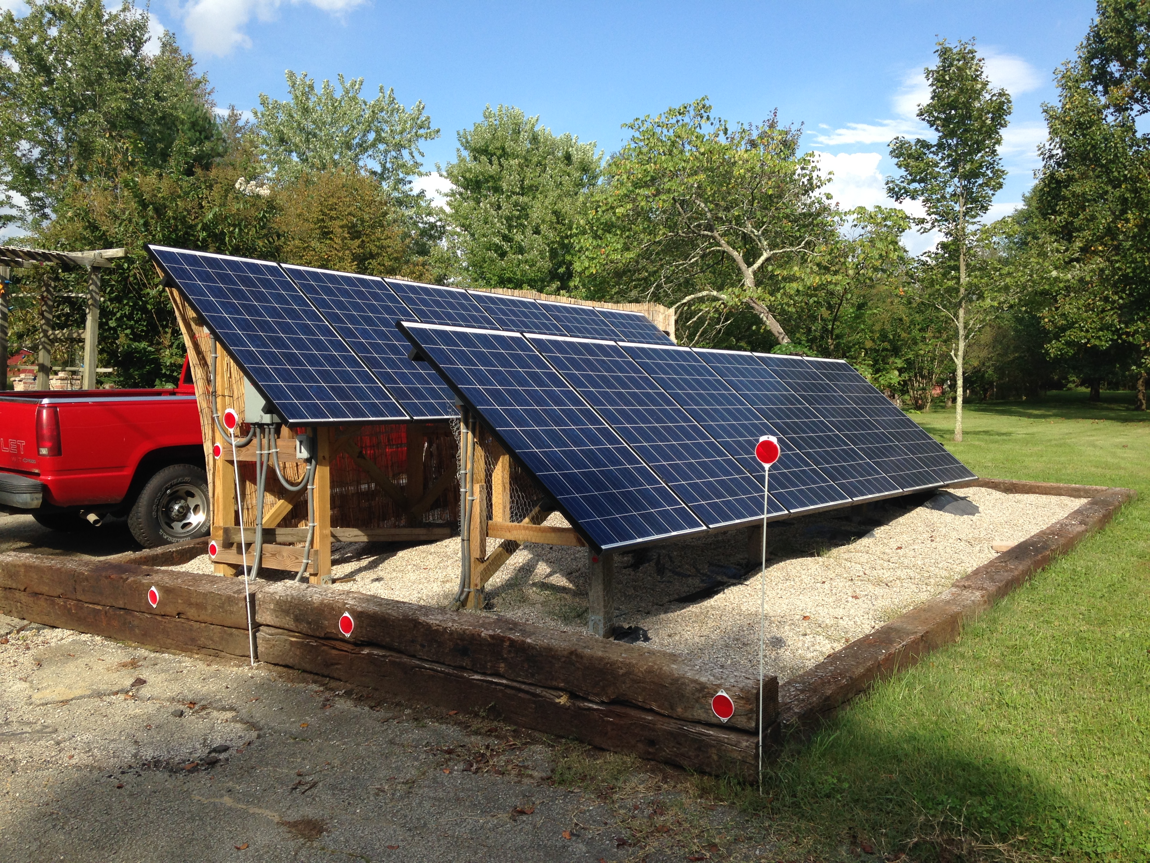
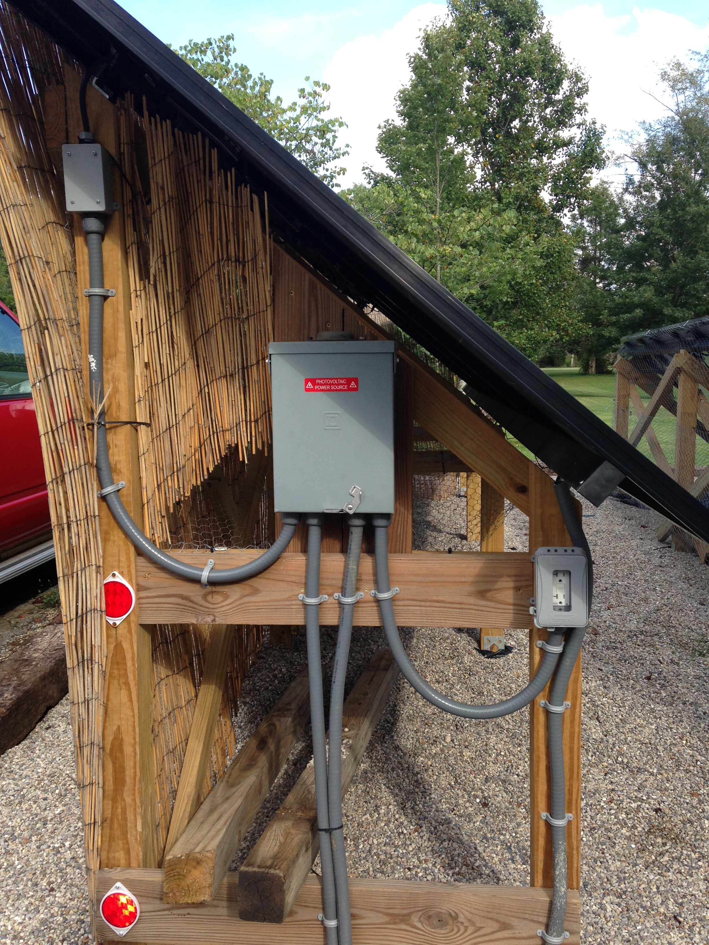

Slide 19
Suppliers
https://www.solarblvd.com/about-us/ low cost panels
https://www.anapode.com/content/Home complete system kits
https://www.wholesalesolar.com/ low cost parts
https://www.invertersupply.com/ low cost racking and inverters
http://www.dudadiesel.com/solar.php solar hot water systems
And of course https://www.ebay.com/
And my personal favorite: https://louisville.craigslist.org/

Slide 20
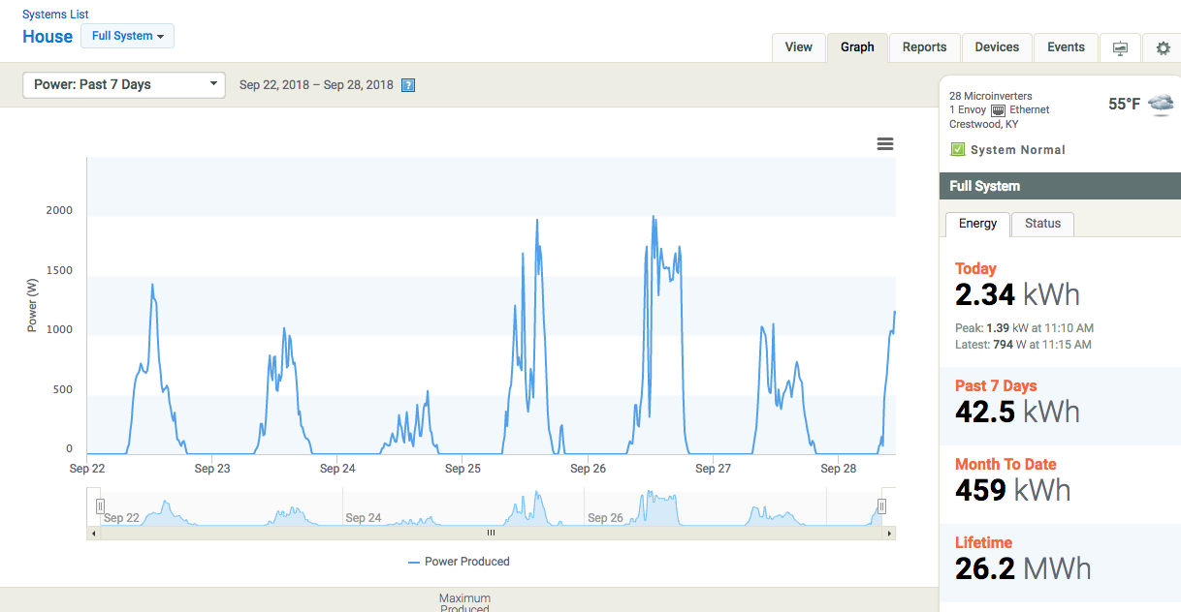
Toys – Enphase enlighten

Slide 21
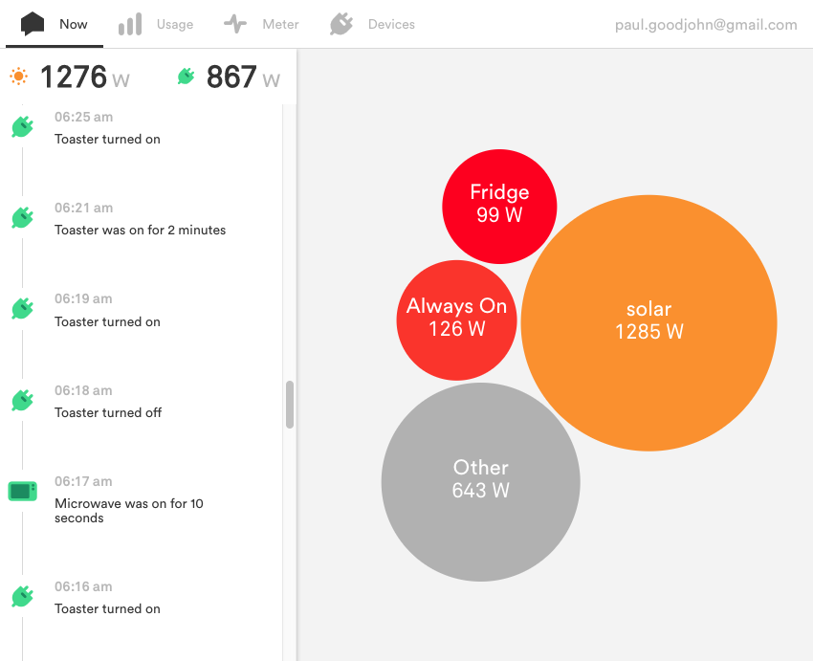
Toys - sense

Slide 22
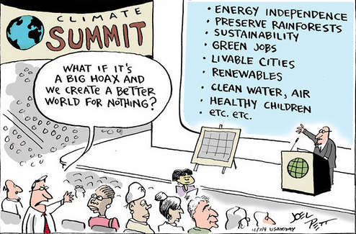
Questions?

